Slide 1
CONSUMER BEHAVIORAL SYSTEM
D COMPANY’S
Presented By:
Soumyadip Sen

Slide 2
SCOPE OF THE PROJECT
Provide data for the demand from the customers and data useful for the suppliers.
Provide data for customer purchase behaviour, improve the sales, specific to location for a given timeline (Daily, Weekly, Quarterly, Monthly, Annually)
Extract information of high value customers and high demand products, that can be used by supply chain department.
Rank items and value customers for sale and offers application.
Enhance the Business.

Slide 3
INTRODUCTION OBJECTIVES
CONCEPTS
To develop an interface enough to Analyze Customer Behavior
Acquiring the dataset
Processing the dataset
Extracting time frame , location etc.
Leader board for Client & Products.
Developing Visual Highlights for viewer.

Slide 4
Physical Layer
customer
Customer(Dim)
Cust_id
Cust_id(Dim)
item
item(Dim)
Load Data
Dependency

Slide 5
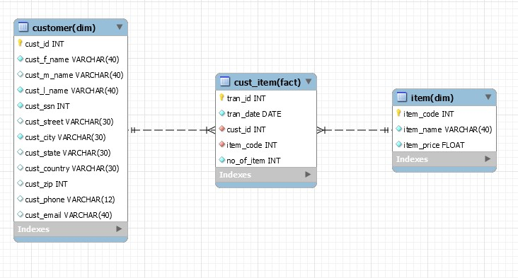
DATA WAREHOUSE SCHEMA

Slide 6


TECHNOLOGIES USED AND THEIR ADVANTAGES
Hive
PySpark
Fast querying
Partitioning available
Uses HiveQL- a declarative language like SQL
Provides the structure on an array of data formats
Speed(100x faster than Hadoop)
Rich APIs for data transformation
Easy SQL interface
Flexible usage
Active and Expanding for future use.

Slide 7
WORK FLOW DIAGRAM
RAW DATA
(CSV)RW DATA
HIVE TABLE
TARGET/ FILE
HiveQL
PySpark

Slide 8
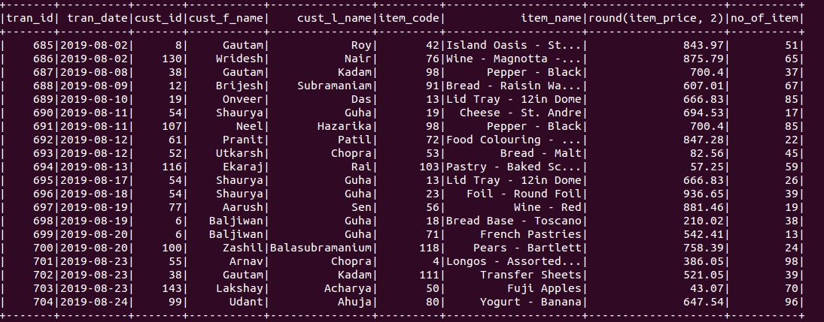
PROCESSED OUTPUTS
REQUIREMENT 1 Customer wise Purchase of Item details

Slide 9
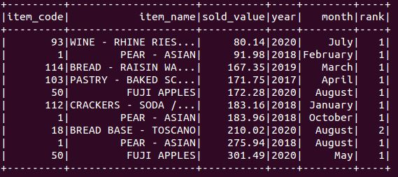
PROCESSED OUTPUTS
REQUIREMENT 2 Least moved 10 items Value wise

Slide 10
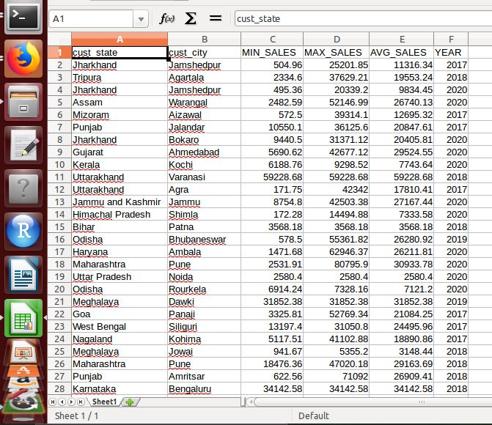
PROCESSED OUTPUTS
REQUIREMENT 3 Min, Max and Avg Purchase Value wise

Slide 11
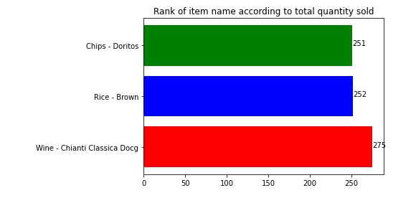
PROCESSED OUTPUTS
REQUIREMENT 4 Top 3 best item sold quantity wise

Slide 12
ANALYSIS
$20,000
Provides the category of customers based on their expenditure in particular month and year.
Identify the least moved items and analyze its demands and supply accordingly.
Segregate the Min ,Max and Avg purchase value wise based on different geographical locations to help the determine the growth on the company.
The Top 3 items sold were identified and will help to determine its growth share in future.

Slide 13
CONCLUSION
$20,000
Enhancing the processing time by using spark.
(through lambda architecture)
● Batch processing is done according to your
requirements.
Restocking information derive number of item needed for the customer in a particular time span as per location.
D Company’s items and customer trends as per needed time period were produced into final reports

Slide 14
THANK
YOU!!!!!

